Slide 1

Home page (befor loggin in)
Compact navigation with few elements.
A clear definitione what can bo done here and what the page is about.
Clear call to action. We know what need to be done.

Slide 2
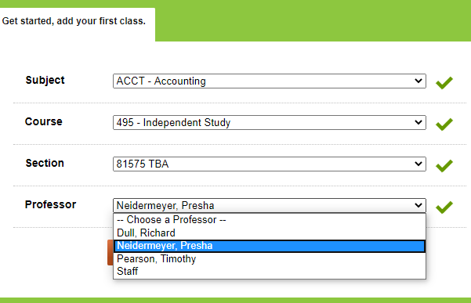
Login – course selection
During registration, the user can immediately add courses that have already been completed. Thanks to this, after logging in, user will be able to fully use the website.
However, it extends the registration proces, therefore it is also possible to skip this part.
Adding courses is done efficiently – the page suggests options and allows to choose instead of forcing the user to remember what is easier for users.

Slide 3

Home page – after logging in
The menu on the right is sorter in order of importance. At the top, subjects and teacher’s grades. The hierarchy seems well structured, but the home page has a lot of elements and various tabs.
CHEAPER TEXTBOOKS – the element that attracts the most attention of the user (monetization function of the website).
The book search engine may be accidentally treated as a search engine for subjects or teachers (because this is the main purpose of the page).

Slide 4
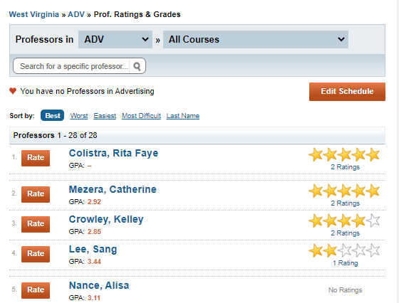
Lecturers and grades
Possibility of sorting by various criteria.
The user can see the numer of search results. In terms of heuristics it provides comfort to the user by showing search status.
The list of lecturers includes the opinion of adding a grade, the numer of GPA points (the equivalent of Polish ECTS points), student grades on teh subject (stars) and the numer of these grades.

Slide 5
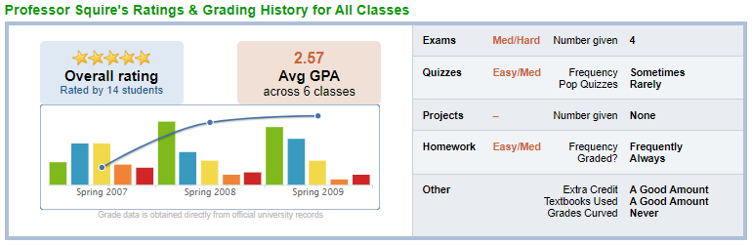
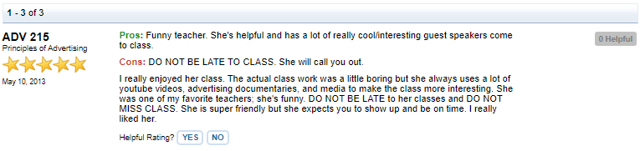
Lecturer profile
Division into subjects provided by the lecturer.
Chart about the distribution grades for the subjects.
Opinions and comments divided into categiories: exams, quizzes, projects, homework and more.
Comments contain fixed parts such as pros and cons, overall rating, date, and the ability to determine whether the comment was useful.

Slide 6
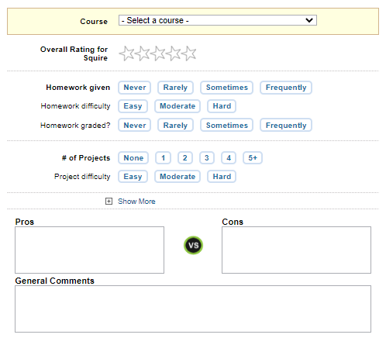
Adding ratings and comments
Adding comments is structured and includes specific options. Thnks to this, each profesor will be assessed in a specific way.
Comments are anonymous.

